Slide 1


Password Management System
GROUP MEMBERS:
Muhammad Shoaib Akhter Qadri (02-131212-009)

Slide 2
2. GROUP MEMBERS
Muhammad Shoaib Akhter Qadri (individual)

Slide 3
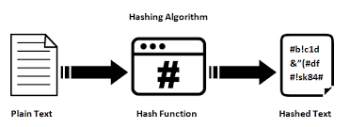
3. ALGORITHM
Hash Algorithm
MD5
SHA-1
SHA-256
Decision Tree(If user forget his password of our password manager Account)

Slide 4
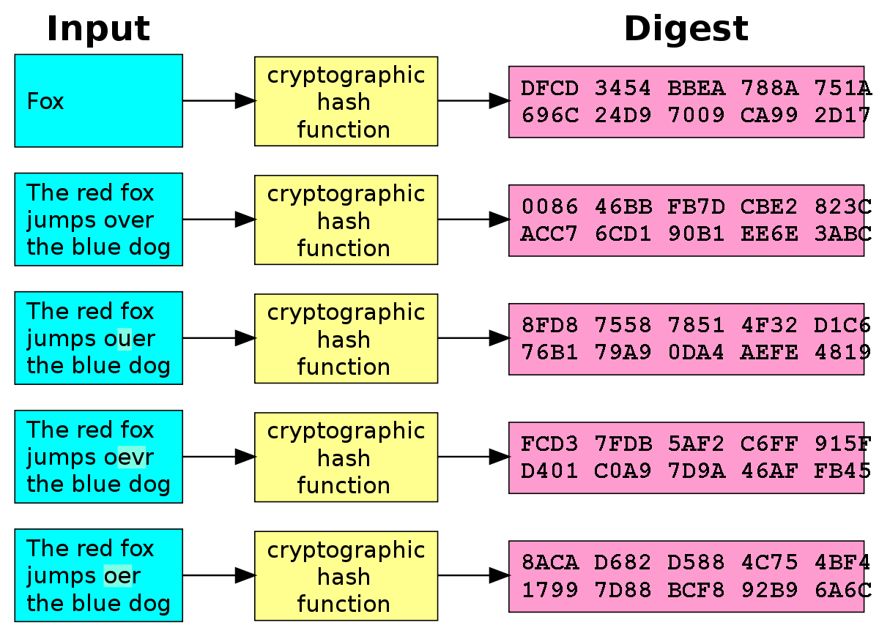

Slide 5
4. WHAT WAS THE PROBLEM
People create their account on Facebook, google, Instagram etc. they all want they should have strong password for their account safety.
They also want that their social account passwords must be saved in their PCs because they want to set different password in different website and it is hard to remember.
People also want to check which encryption is better for their product having login or sign up

Slide 6
5. SOLUTION OF THE PROBLEM
Our software generate strong password with any provided Length which can be easily copied by user and paste on their website.
User also save/create that automatic generated password and store the password he created for account with website name, social platform name and other details like username on their PC. And he can delete also.
Protect User’s Password by using SHA-1, SHA-2 and SHA-512 Encryption

Slide 7

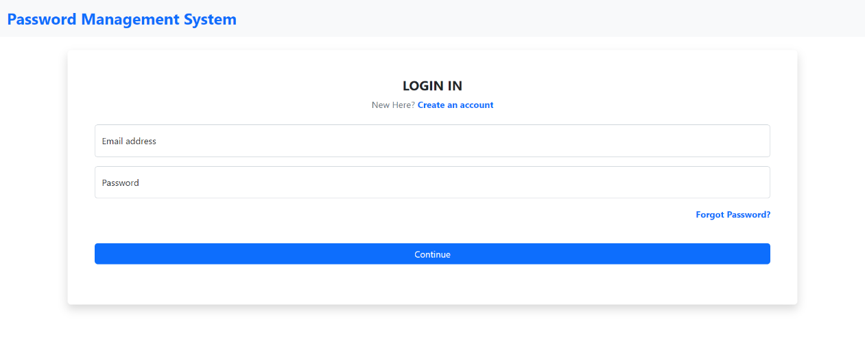



6. PROJECT INTERFACE

Slide 8
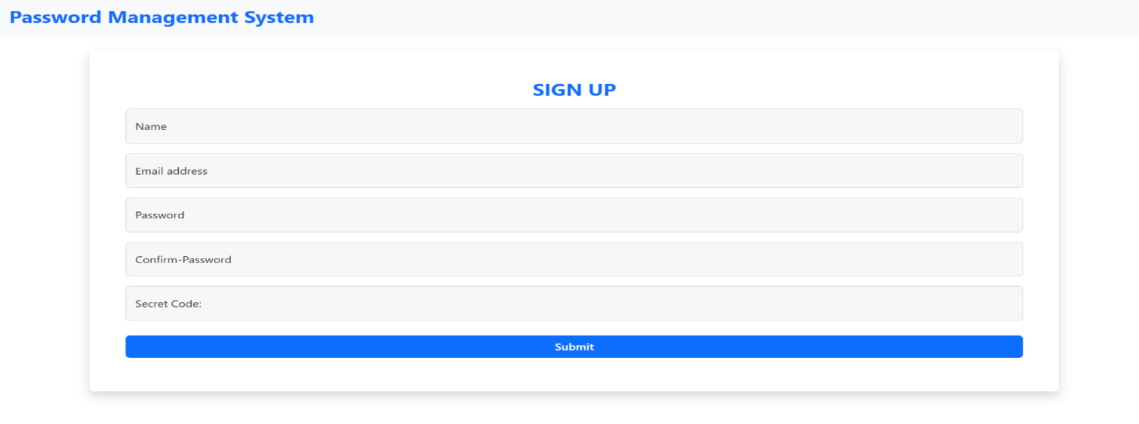

Slide 9
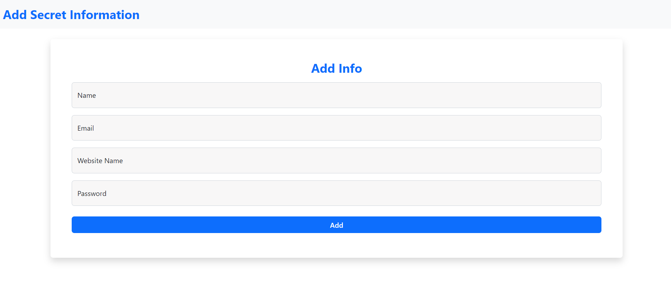
6. PROJECT INTERFACE (New Password Form)

Slide 10
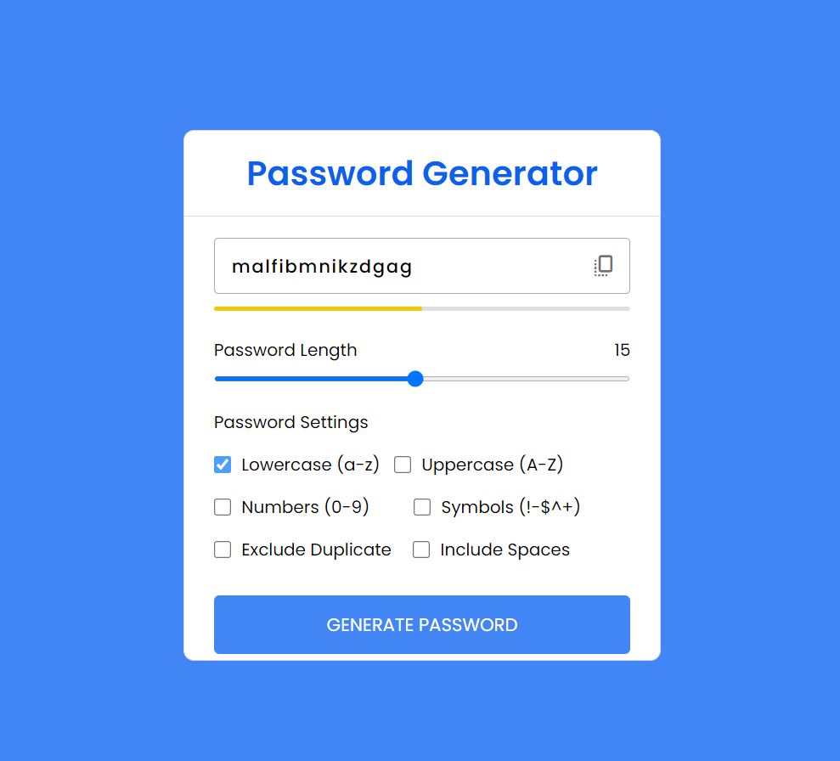
6. PROJECT INTERFACE (Random Password Generate )

Slide 11
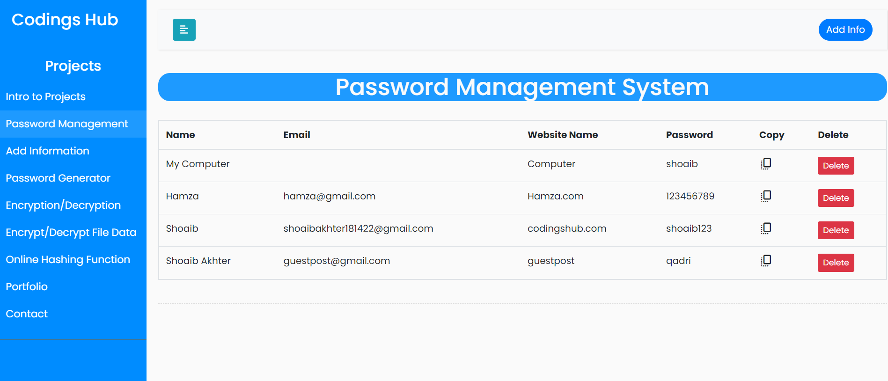
6. PROJECT INTERFACE (DashBoard)

Slide 12
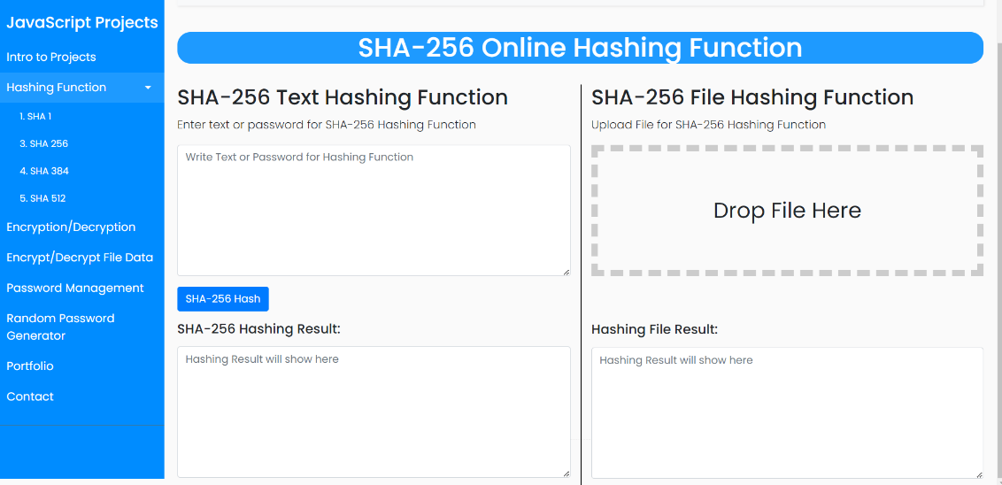
6. PROJECT INTERFACE (Continue)

Slide 13
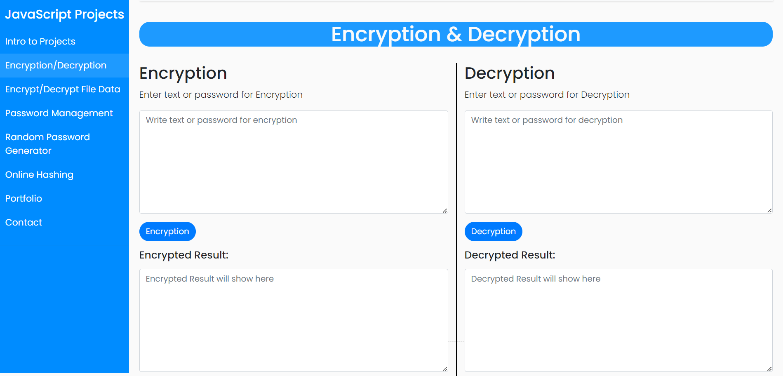
6. PROJECT INTERFACE (Continue)

Slide 14
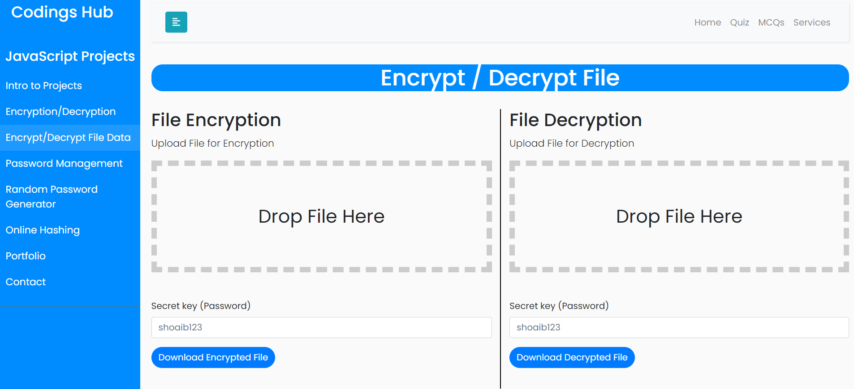
6. PROJECT INTERFACE (Continue)

Slide 15
7. RESPONSIBILITY OF EACH MEMBER IN THE PROJECT
Muhammad Shoaib Akhter Qadri:
I built these 8 projects in which
Password Management System
Online Random Password Generator
Only Hashing Function
SHA-1
SHA-256
SHA-358
SHA-512
Encryption/Decryption Text
Encryption/Decryption File

Slide 16
THANKS

